Slide 1



UIMSMobi.le
with
Author
Supervisor
Cagri CAKIR
Aleksey BONDAREV
2013-2014
INternational AtatURk-Alatoo University
DEPARTMENT OF COMPUTER SCIENCE
UIMSM
UIMSM

Slide 2



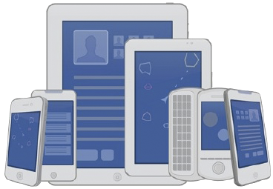

Issue What is the problem?
Currently, UIMS only works on internet browsers:
a user needs to have;
a computer with an internet browser, or
a mobile device with a mobile internet browser
17.4% of Global Web Traffic Comes Through Mobile
nternational AtatURk-Alatoo University
DEPARTMENT OF COMPUTER SCIENCE
UIMSM
UIMSM
Notes:
-I devided to divide the project in three parts
-first is about what actually I want to make
-second part is about what we have got to design it
-and the last part is advanced part, which will make me have some headacts. Because its all about communication

Slide 3
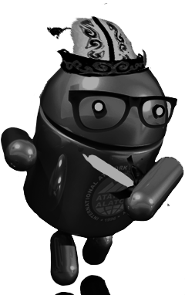
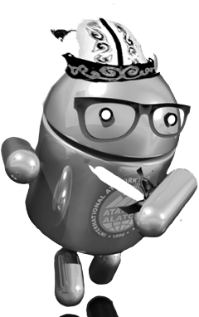
Outline
Issue
What is the problem?
Motivation
Why is it important?
Related works
What have others done?
Methods
What we have done?
What is my approach?
Results
How is data transmitted and received?
Is there another important operation?
How about other features?
Summary
What was the project made with?
Future work
What can we do more?
nternational AtatURk-Alatoo University
DEPARTMENT OF COMPUTER SCIENCE
UIMSM
UIMSM
Notes:
-I devided to divide the project in three parts
-first is about what actually I want to make
-second part is about what we have got to design it
-and the last part is advanced part, which will make me have some headacts. Because its all about communication

Slide 4
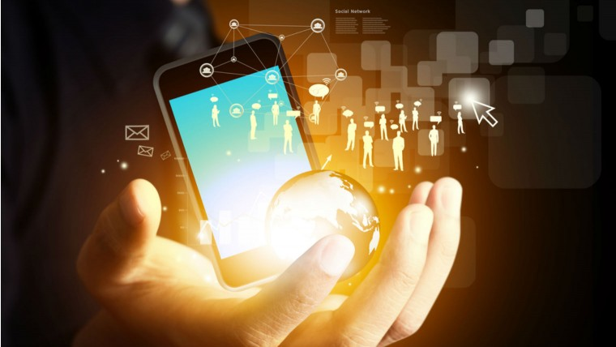
Motivation Why is it important?
Digital Age requires an easy-access to information
The future of internet access is mobile
Easy-access to students as clients
«Technology has not only made access to information easier, it has arguably made learning easier by making it less challenging and letting us get away with using system one more often.»
Robert Allen Bjork
(Ph.D., Stanford University; B.A., Minnesota)
Faster sharing academic information
nternational AtatURk-Alatoo University
DEPARTMENT OF COMPUTER SCIENCE
UIMSM
UIMSM
Notes:
-I devided to divide the project in three parts
-first is about what actually I want to make
-second part is about what we have got to design it
-and the last part is advanced part, which will make me have some headacts. Because its all about communication

Slide 5








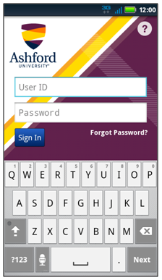
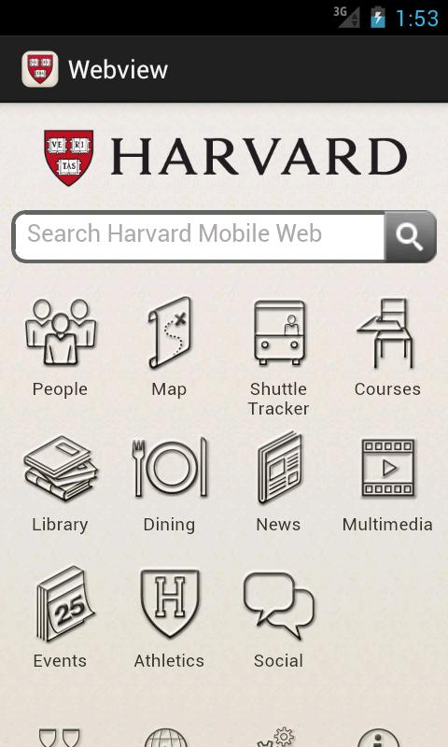
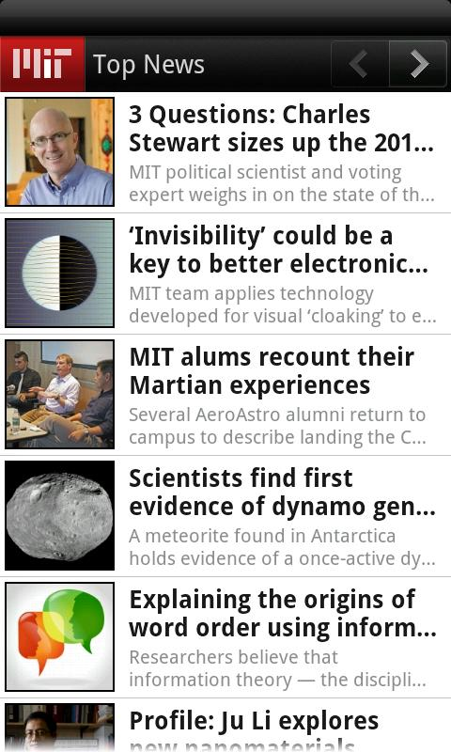
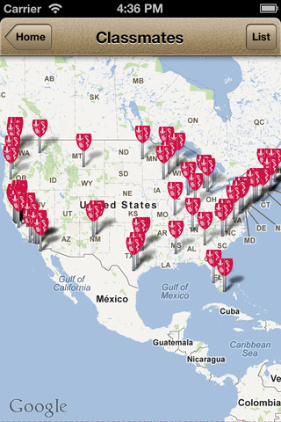
Related works What have others done?
Currently, most of universities and colleagues have their mobile applications
nternational AtatURk-Alatoo University
DEPARTMENT OF COMPUTER SCIENCE
UIMSM
UIMSM
Notes:
-I devided to divide the project in three parts
-first is about what actually I want to make
-second part is about what we have got to design it
-and the last part is advanced part, which will make me have some headacts. Because its all about communication

Slide 6
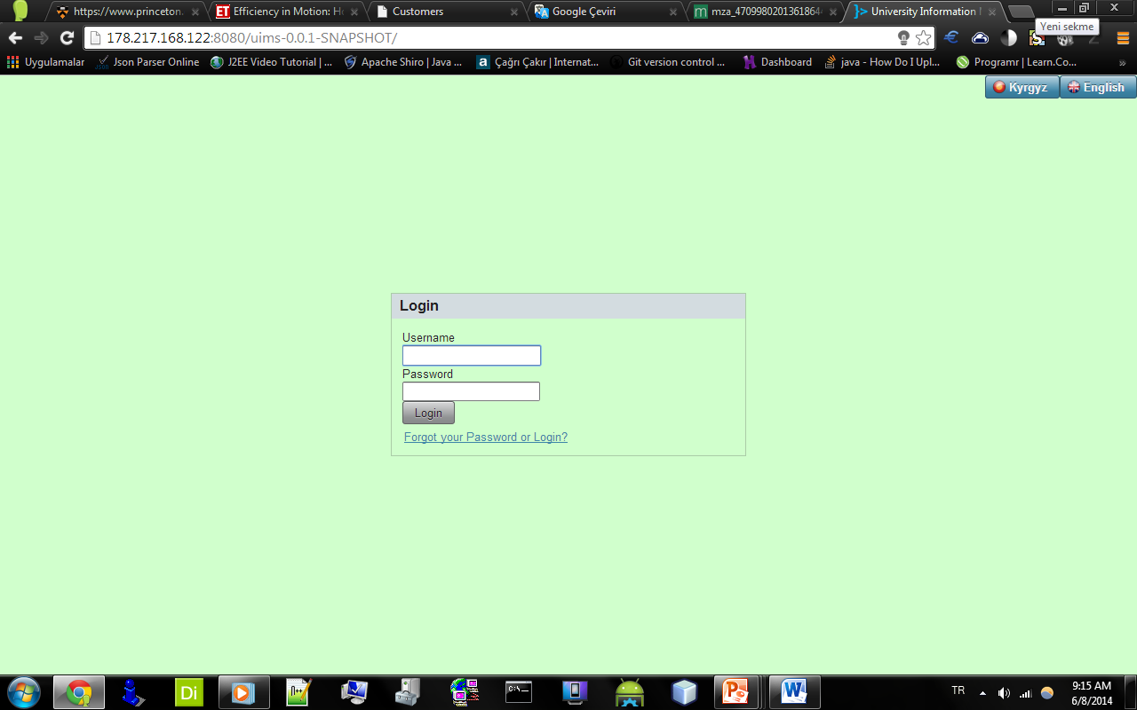
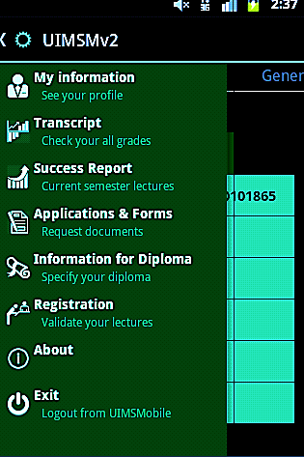
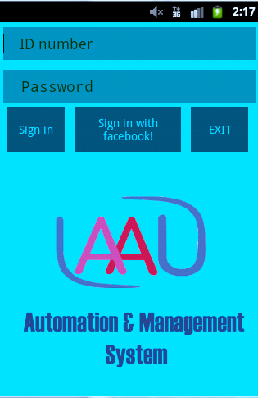
Methods What we have done
Android application activity
for authorizing
UIMS Mobile
Android application main slide menu
Authentication area of UIMS,
University Information
Management System
nternational AtatURk-Alatoo University
DEPARTMENT OF COMPUTER SCIENCE
UIMSM
UIMSM
Notes:
-I devided to divide the project in three parts
-first is about what actually I want to make
-second part is about what we have got to design it
-and the last part is advanced part, which will make me have some headacts. Because its all about communication

Slide 7
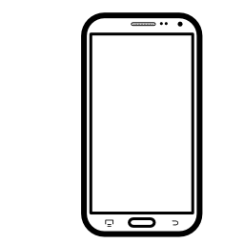

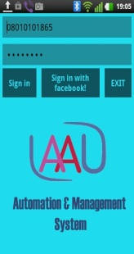



Methods What is my approach?
Client: mobile
HTTP response by JSON
Server
HTTP request by JSON
Internet
Client: desktop
Server: database
nternational AtatURk-Alatoo University
DEPARTMENT OF COMPUTER SCIENCE
UIMSM
UIMSM
Notes:
-I devided to divide the project in three parts
-first is about what actually I want to make
-second part is about what we have got to design it
-and the last part is advanced part, which will make me have some headacts. Because its all about communication

Slide 8
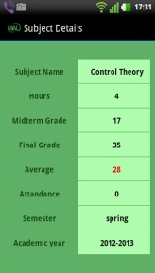

Results How is data transmitted and received?
Client: mobile
HTTP response by JSON
{
"SuccessReport":
{
"1":
{
"subject_name": "Control Theory ",
"hours": "4",
"midterm": "17",
"final": "35",
"average": "28",
"attandace": "0",
"semester": "spring",
"academic_year": "2012-2013"
},
…
}
}
Server
Responsed JSON data structure over HTTP
Server: database
nternational AtatURk-Alatoo University
DEPARTMENT OF COMPUTER SCIENCE
UIMSM
UIMSM
Notes:
-I devided to divide the project in three parts
-first is about what actually I want to make
-second part is about what we have got to design it
-and the last part is advanced part, which will make me have some headacts. Because its all about communication

Slide 9

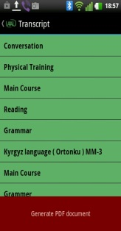
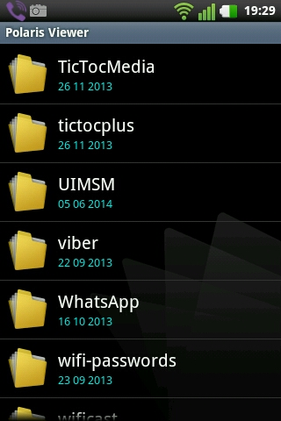
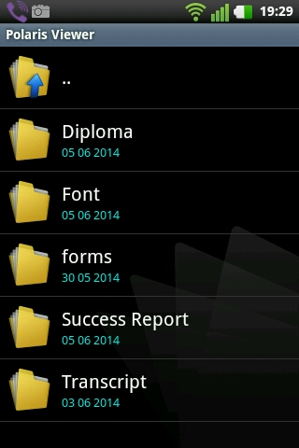
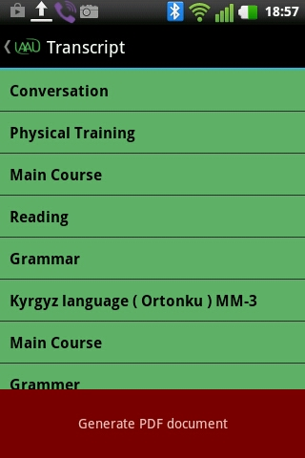
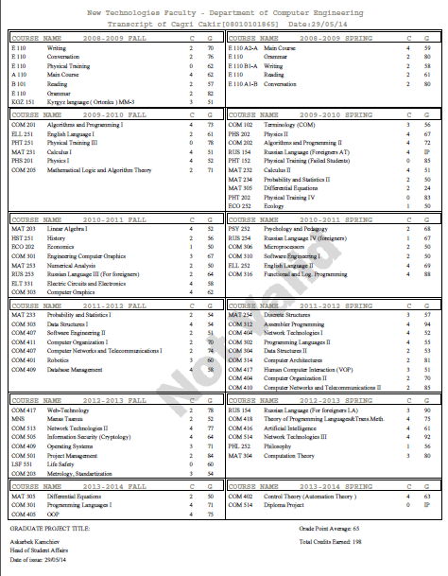
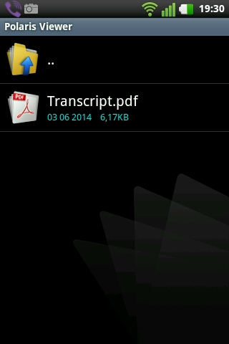
Results Is there another important operation?
Client: mobile
Creation App folder structure in external storage (SDCard)
iText
Programmable
PDF Library
PDF report generation
nternational AtatURk-Alatoo University
DEPARTMENT OF COMPUTER SCIENCE
UIMSM
UIMSM
Notes:
-I devided to divide the project in three parts
-first is about what actually I want to make
-second part is about what we have got to design it
-and the last part is advanced part, which will make me have some headacts. Because its all about communication

Slide 10
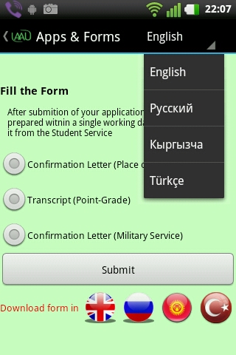
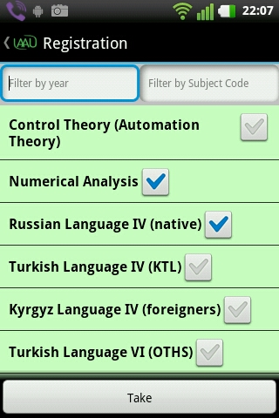
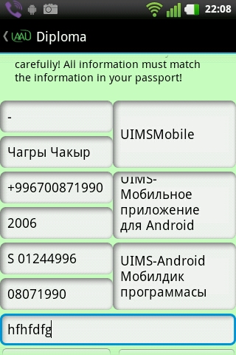
Results How about other features?
Clients are able to request Applications and forms as well as in UIMS
As in UIMS, students can also register their untaken courses
Undergraduate students are able to inform their diploma information
nternational AtatURk-Alatoo University
DEPARTMENT OF COMPUTER SCIENCE
UIMSM
UIMSM
Notes:
-I devided to divide the project in three parts
-first is about what actually I want to make
-second part is about what we have got to design it
-and the last part is advanced part, which will make me have some headacts. Because its all about communication

Slide 11
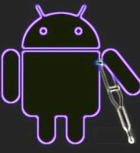






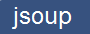


Summary What was the project made with?
Technologies
Client Side
Server Side
WEB SERVER
DESIGN
JAVA EE®
TRANSMISSION
DATABASE
GENERATION PDF
ITEXT®
nternational AtatURk-Alatoo University
DEPARTMENT OF COMPUTER SCIENCE
UIMSM
UIMSM
Notes:
-I devided to divide the project in three parts
-first is about what actually I want to make
-second part is about what we have got to design it
-and the last part is advanced part, which will make me have some headacts. Because its all about communication

Slide 12





Future Work What can we do more?
University's owned services
MOBILE
nternational AtatURk-Alatoo University
DEPARTMENT OF COMPUTER SCIENCE
UIMSM
UIMSM
Notes:
-I devided to divide the project in three parts
-first is about what actually I want to make
-second part is about what we have got to design it
-and the last part is advanced part, which will make me have some headacts. Because its all about communication

Slide 13
REFERENCES
Learn Java for Android Development Copyright © 2010 by Jeff “JavaJeff” Friesen
Sams Teach Yourself Android™ App Development in 24 Copyright © 2010 Lauren Darcey and Shane Conder
Hello, Android Introducing Google’s Mobile Development Platform 3rd Edition: Ed Burnette The Pragmatic Bookshelf
developer.android.com Creative Commons Attribution Generic (CC BY 2.5)
THANKS FOR
ATTENTION
INternational AtatURk-Alatoo University
DEPARTMENT OF COMPUTER SCIENCE
UIMSM
UIMSM

